Slide 1

Slack Channel:
bit.ly/wfww-slack-invite
Wi-Fi
Login:
Psd:
Basic Programming Workshop
(Instructors)

Slide 2
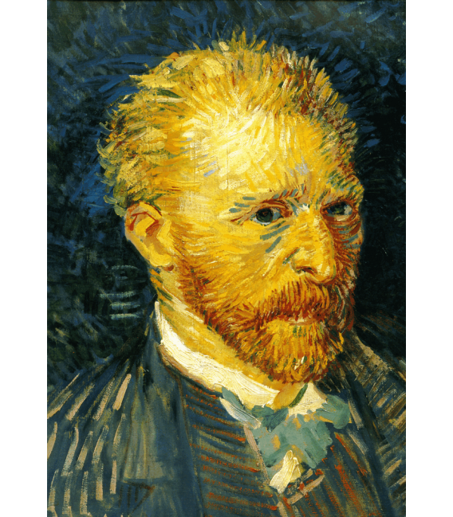

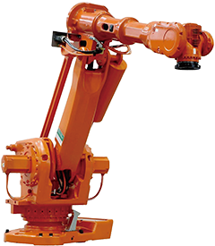
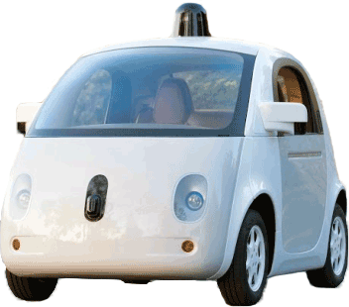
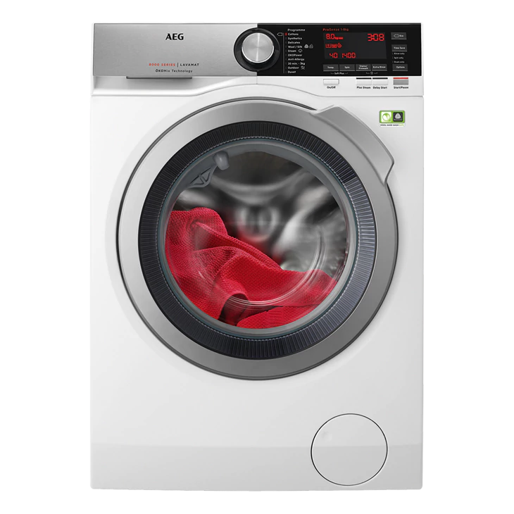
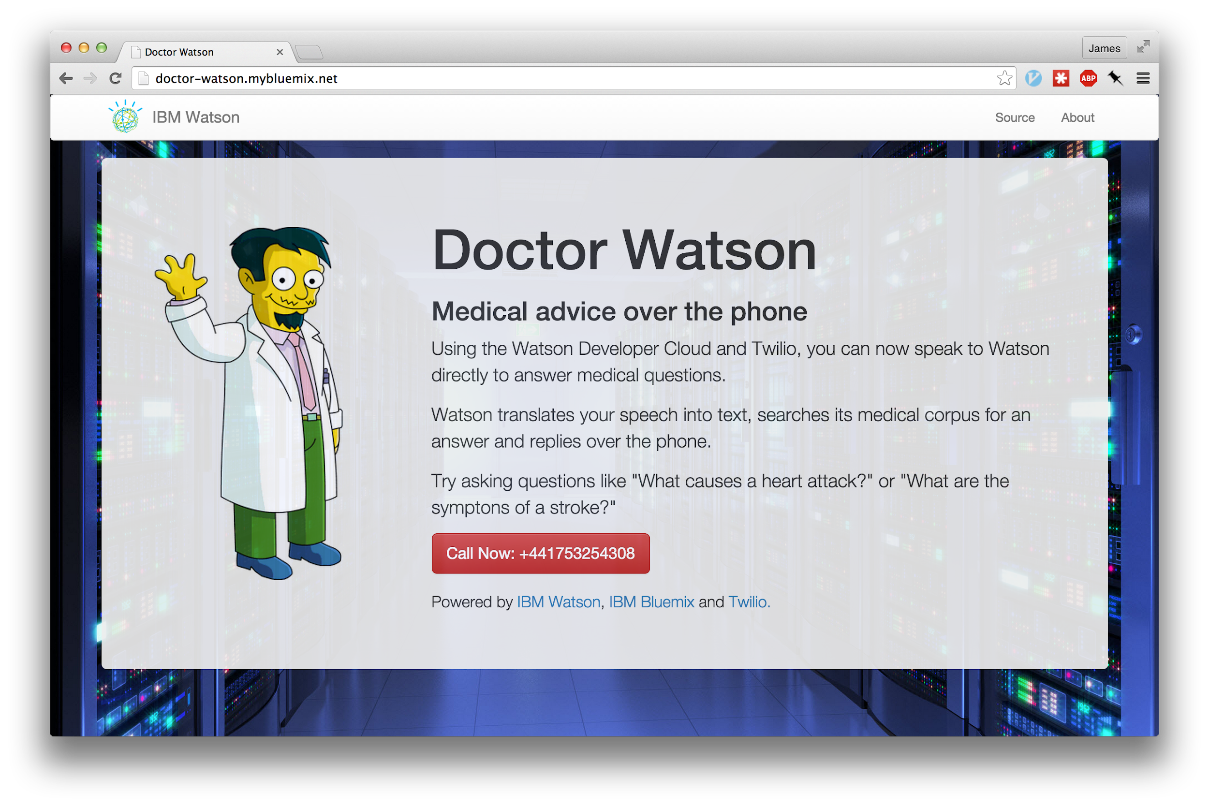

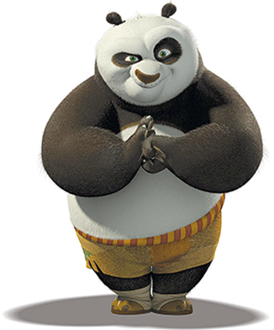
Programming is a tool for…
Notes:
You can think of programming as a tool to do some actions. Do you have any ideas what can we program? Programming robots (industry, washing machine, cars)
Creating applications (mobile phone, facebook)
Creating Art (fractals, VanGogh)
Help doctors (ibm watson)
3-D animations (disney, game)

Slide 3


What with Python?

Slide 4
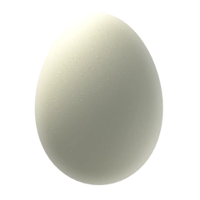
Let’s boil an egg
START
Ingredients: 1 Egg 0.5 l of water
Instructions: 1. Start boiling the water in a pot.
2. When the water is boiling, put in eggs.
3. Boil for 10 minutes.
4. Take out the egg from the pot.
egg = 1
water = 0.5
VARIABLES
Warm up water.
OPERATION or FUNCTION
No
Yes
Is water boiling?
CONDITIONAL STATEMENT
Put the egg in the pot.
Check the timer.
Is it 10min?
Yes
No
Take out the egg.
END

Slide 5
Integrating egg recipe with python
START
egg = 1
water = 0.5
egg = 1 water = 0.5
while water IS NOT boiled: warmUp(water)
putInPot(egg)
for time in range(0, 10): wait1min(1)
take(egg)
VARIABLES
Warm up water.
CONDITIONAL STATEMENT
WHILE LOOP
No
Yes
Is water boiling?
FUNCTION
Put the egg in the pot.
FUNCTION
Check the timer.
FOR LOOP
Is it 10min?
Yes
No
FUNCTION
FUNCTION
Take out the egg.
END

Slide 6
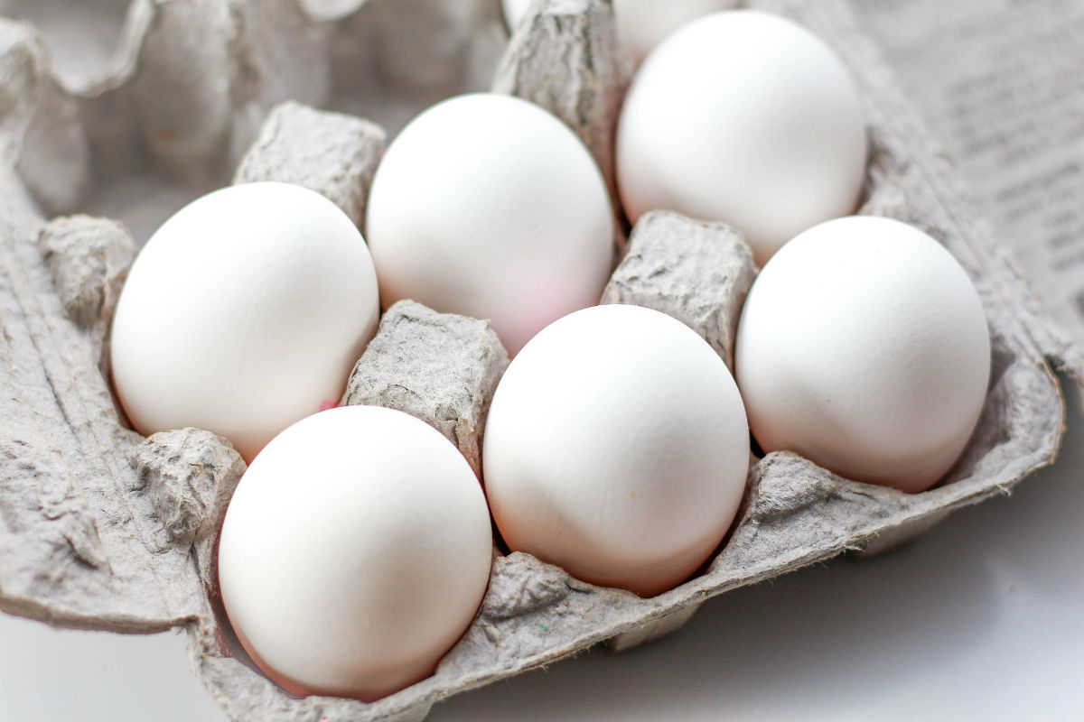
Let’s put 6 eggs one by one in the pot
START
LIST / ARRAY
box = [‘egg0’, ‘egg1’, ‘egg2’, ‘egg3’, ‘egg4’, egg5’] i = 0
while box: putInPot(box[i]) i = i + 1
box = 1st egg, 2nd egg, … 6th egg i = 1
VARIABLE
Put ith egg from the box to the pot.
WHILE LOOP
FUNCTION
Yes
Are there more eggs?
No
i = i + 1
OPERATION
END

Slide 7
We need your feedback:
bit.ly/wfww-bp3-feedback

